Slide 1


IBM Applied Data Science Capstone Project
Battle of the Neighbourhoods: New York vs Toronto
By – Sankalp Manoj Gosawi

Slide 2
Scenario
Suppose, a person has been living in East York, Toronto for 15 sweet years of his/her life.
Now he has to leave East York and relocate to Manhattan, New York for a change in his job location or some other event.
Now, he has been used to a particular lifestyle for a longtime. He may like to go to Mexican restaurants for breakfast, maybe he loves to visit some kind of park on weekends
Now, he would more like to choose a neighborhood in Manhattan which has all the amenities he was used to in a close proximity.

Slide 3
Objective
Applying k-mean clustering algorithm to cluster the neighborhood based on their similarities in different amenities and venues.
For defining success we will try to figure out the optimal cluster size by doing some exploratory data analysis on different clusters and trying to observe their similarities.

Slide 4
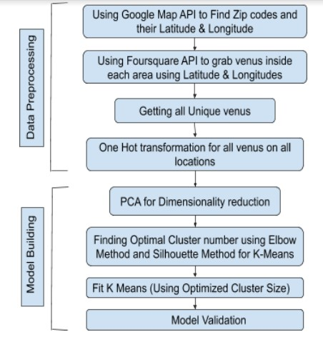
Workflow
Figure 1. Neighborhood segmentation work flow chart

Slide 5
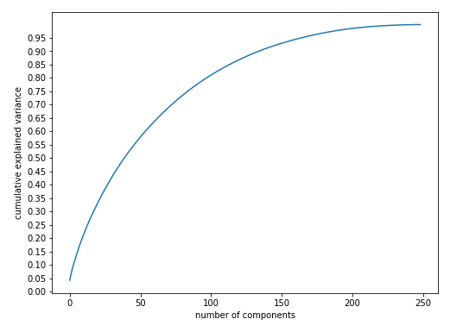
Selecting Principal Components
Figure 2. Selecting Principal Components

Slide 6
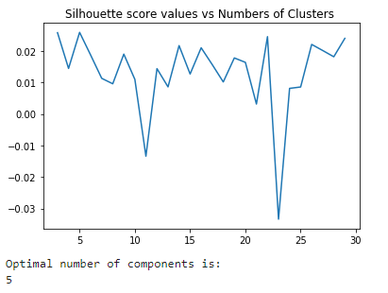
Silhouette Score
Figure 3. Silhouette Score confirms optimal Cluster Number 5

Slide 7
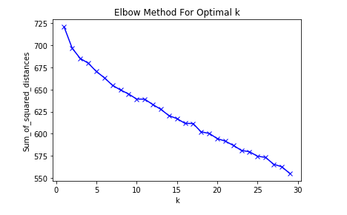
Elbow Method
Figure 4. Elbow found at k =5 (K is number of Clusters)

Slide 8
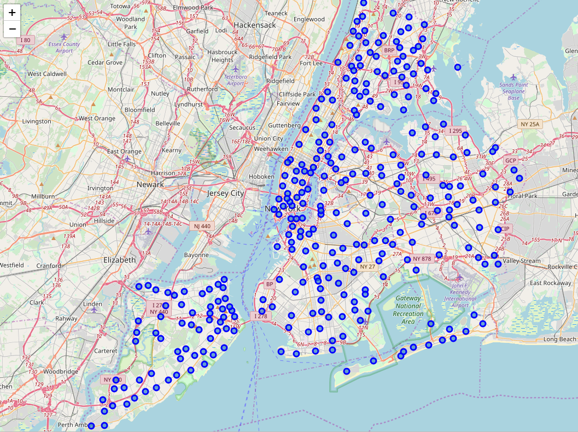
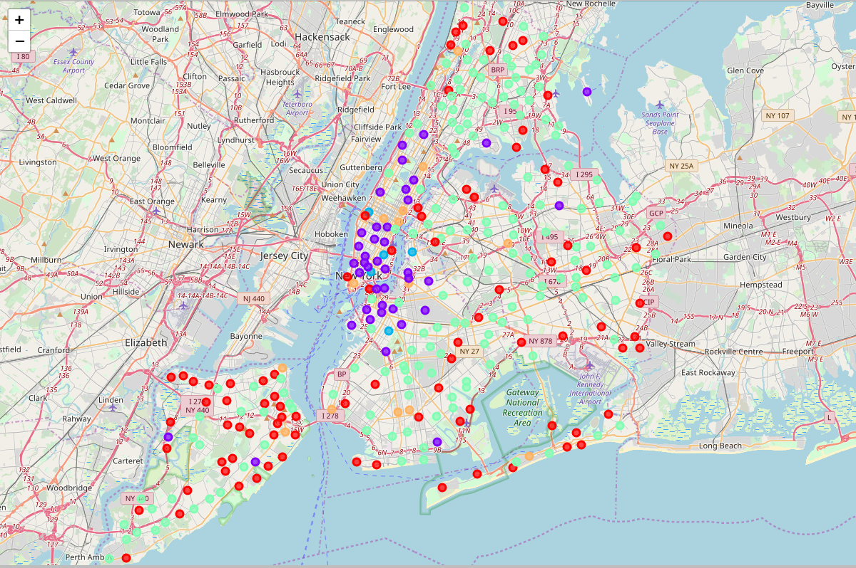
Cluster Visualization
Before Clustering
After Clustering
Figure 5. New York Zip codes with the assigned cluster label

Slide 9
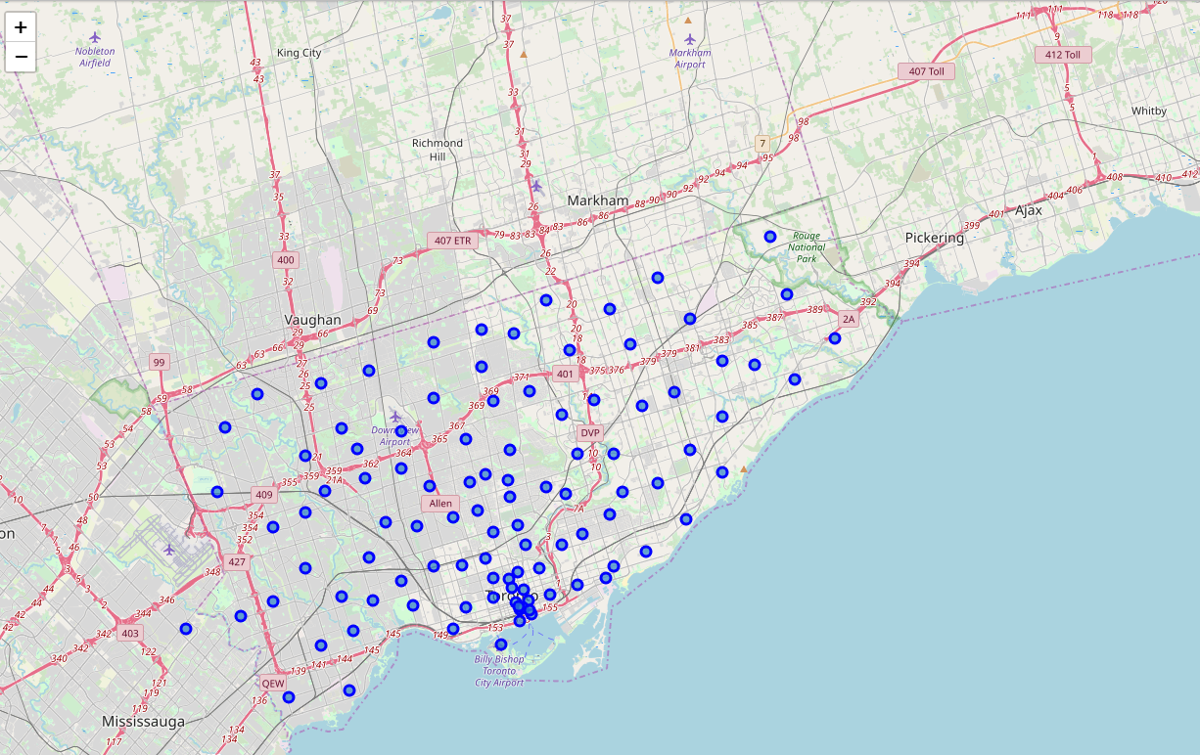
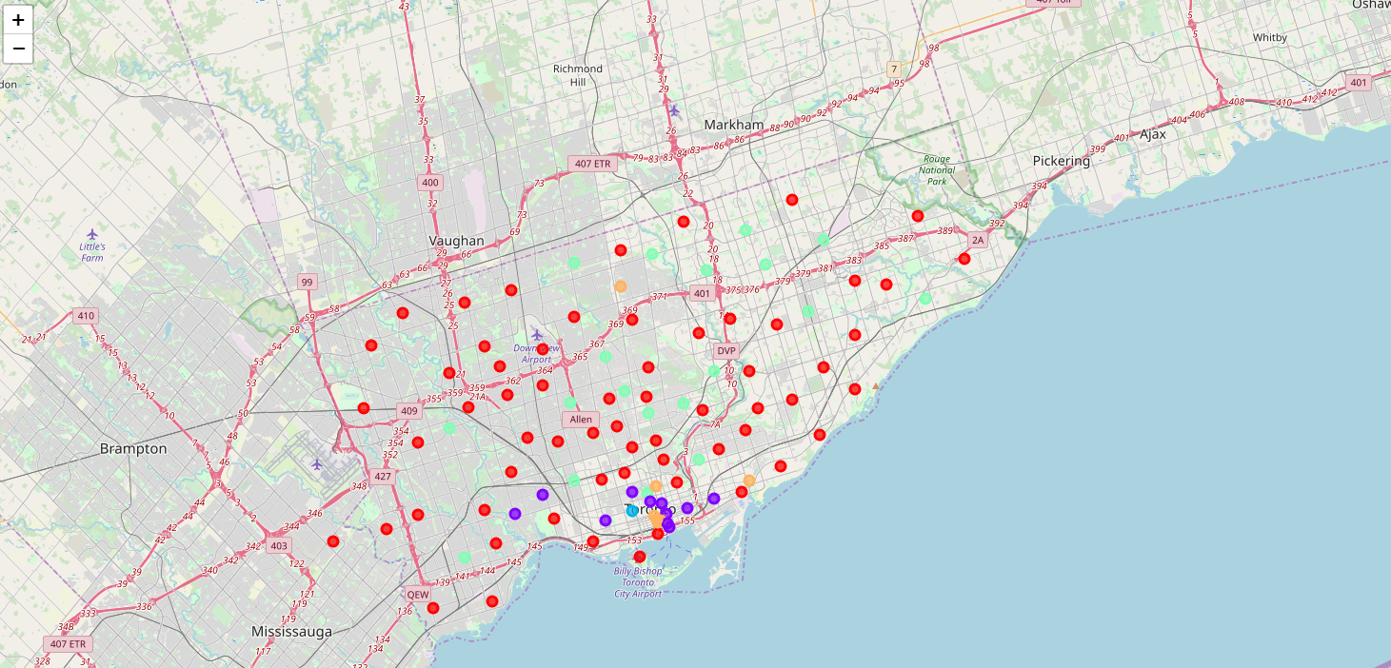
Cluster Visualization
Before Clustering
After Clustering
Figure 5. Toronto Zip codes with the assigned cluster label

Slide 10
Conclusion
The project work was only done on the zip codes of New York and Toronto, which includes 401 zip codes each having 150 features even after dimensionality reduction with PCA. The problem is that we have a huge feature space but limited number of samples. We can collect data from entire United States and Canada, which will make our dataset well balanced.
From figure 5 and 6, we can spot certain outlier in our data. In future we will try to filter out those outliers for more robust clustering.
There could be other clustering algorithms that can work better. In future, DBSCAN seems to be a good fit for our data.
We can sum everything, and convert to a neighborhood recommendation APP.

Slide 11
Thank You!

